Slide 1
Decorator Design Pattern
Siddesh A S
1hk17cs138

Slide 2
Decorator Design pattern
"Attach additional responsibilities to an object dynamically.
Decorators provide a flexible alternative to sub classing for
extending functionality“
Falls under the category of Structural Design Pattern and is also
known as Wrapper

Slide 3
Implementation Guidelines Choose Decorator Design Pattern
Need to add responsibilities to individual objects dynamically and transparently
The Extension by sub classing is impractical
Class definition may be hidden
Classes are unavailable for sub classing

Slide 4
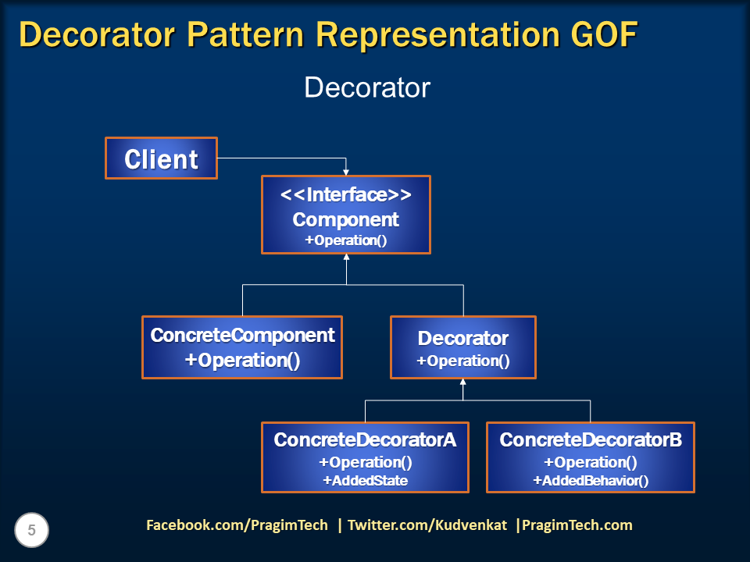
Decorator Pattern Representation

Slide 5
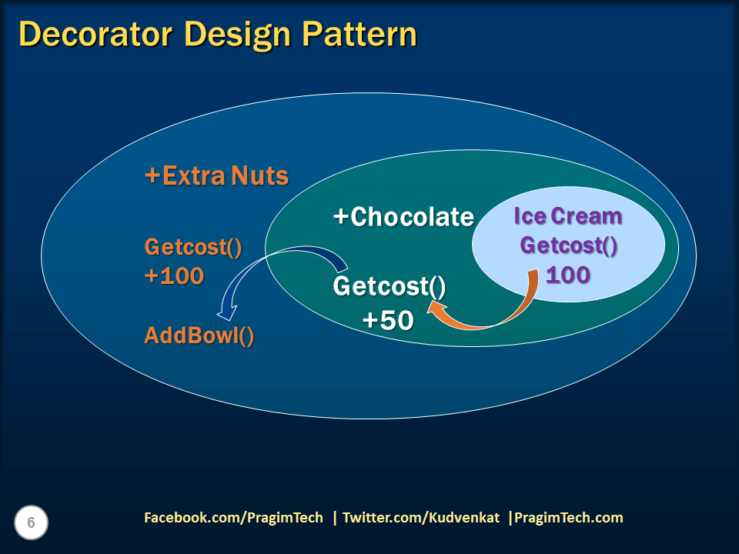
Decorator Design Pattern

Slide 6
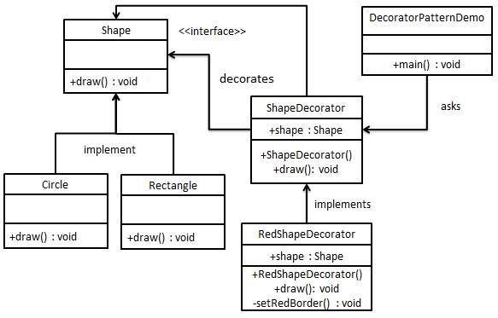
Decorator Pattern Demo

Slide 7
Step 1 Create an interface.
Shape.java
public interface Shape {
void draw();
}

Slide 8
Step 2 Create concrete classes implementing the same interface.
Rectangle.java
public class Rectangle implements Shape {
@Override
public void draw() {
System.out.println("Shape: Rectangle");
}
} Circle.java
public class Circle implements Shape {
@Override
public void draw() {
System.out.println("Shape: Circle");
}
}

Slide 9
Step 3 Create abstract decorator class implementing the Shape interface
ShapeDecorator.java
public abstract class ShapeDecorator implements Shape {
protected Shape decoratedShape;
public ShapeDecorator(Shape decoratedShape){
this.decoratedShape = decoratedShape;
}
public void draw(){
decoratedShape.draw();
}
}

Slide 10
Step 4 Create concrete decorator class extending the Shape Decorator class.
RedShapeDecorator.java
public class RedShapeDecorator extends ShapeDecorator {
public RedShapeDecorator(Shape decoratedShape) {
super(decoratedShape);
}
@Override
public void draw() {
decoratedShape.draw();
setRedBorder(decoratedShape);
}
private void setRedBorder(Shape decoratedShape){
System.out.println("Border Color: Red");
}
}

Slide 11
Step 5 Use the Red Shape Decorator to decorate Shape objects.
DecoratorPatternDemo.java
public class DecoratorPatternDemo {
public static void main(String[] args) {
Shape circle = new Circle();
Shape redCircle = new RedShapeDecorator(new Circle());
Shape redRectangle = new RedShapeDecorator(new Rectangle());
System.out.println("Circle with normal border");
circle.draw();
System.out.println("\nCircle of red border");
redCircle.draw();
System.out.println("\nRectangle of red border");
redRectangle.draw();
}
}

Slide 12
Step 6 output.
Circle with normal border
Shape: Circle
Circle of red border
Shape: Circle
Border Color: Red
Rectangle of red border
Shape: Rectangle
Border Color: Red

